Slide 1
Image Forgery Detection

Slide 2
Team Members
IoTE28 Jisan Khan
IoTE51 Soman Sukale
IoTE63 Shardul Vanage
IoTE64 Abhishek Vishwakarma
Under the guidance of
Dr. Sheeba P.S.

Slide 3
Agenda
Introduction
Problem Statement
Research Objective
Literature Review
Workflow
Interface
Conclusion

Slide 4
Introduction
With over 4.5 billion active internet users, the amount of multimedia content being shared every day has surpassed everyone’s imagination. Large-scale and pervading social media platforms, along with easily accessible smartphones, have given rise to huge visual data such as images etc. One of the perils accompanying this huge amount of data is manipulation and malicious intent to remove the authenticity of these media. The availability of various image-editing software and tools such as Photoshop, GIMP, etc., has made it possible to create forgeries with minimal effort. Today, it is quite easy to produce a manipulated media that looks indifferent to the human eyes. Various types of digital image forgeries have evolved, the major ones include copy-move, morphing, watermarking, etc. But there is no reliable way of detecting these changes. We can create a model using Deep Learning to tackle this problem.

Slide 5
Problem Statement
With the advent of social networking services such as Facebook and Instagram, there has been a huge increase in the volume of image data generated in the last decade. Use of image (and video) processing software like GNU Gimp, Adobe Photoshop to create doctored images and videos is a major concern for internet companies like Facebook. These images are prime sources of fake news and are often used in malevolent ways such as for mob incitement. Before action can be taken on basis of a questionable image, we must verify its authenticity.

Slide 6
Research Objective
To find effective and efficient techniques to accurately detect and identify manipulated images.
These techniques should be able to detect various types of image forgeries such as copy-move, splicing, and retouching.
There should be no limitations on image type i.e. png, jpg, jpeg etc.

Slide 7
Literature Review
CNNs can be used for pre-processing the image.
There are many forgery detection techniques:
Copy-Move Forgery
Double Jpeg Compression
Noise Variance Inconsistency
Metadata Analysis
Different models available for forgery detection:
Error Level Analysis
VGG16
VGG19

Slide 8
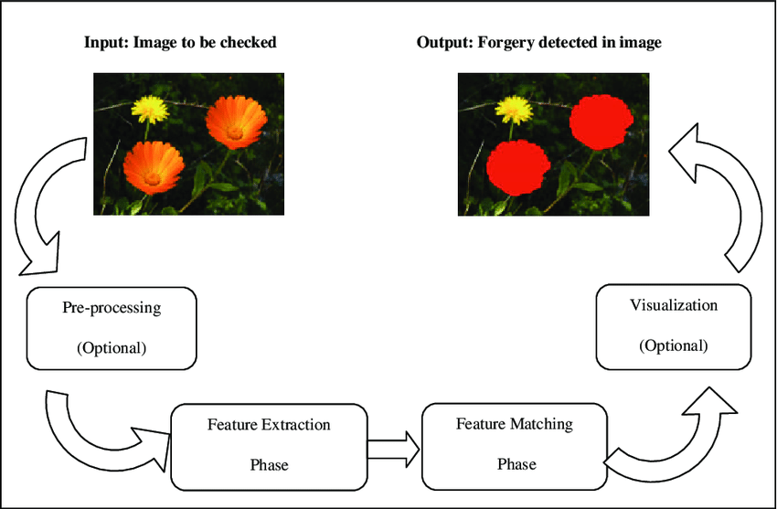
General Workflow

Slide 9
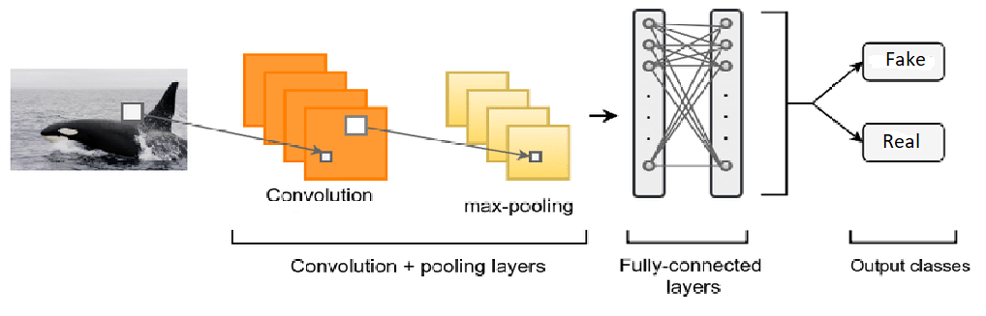
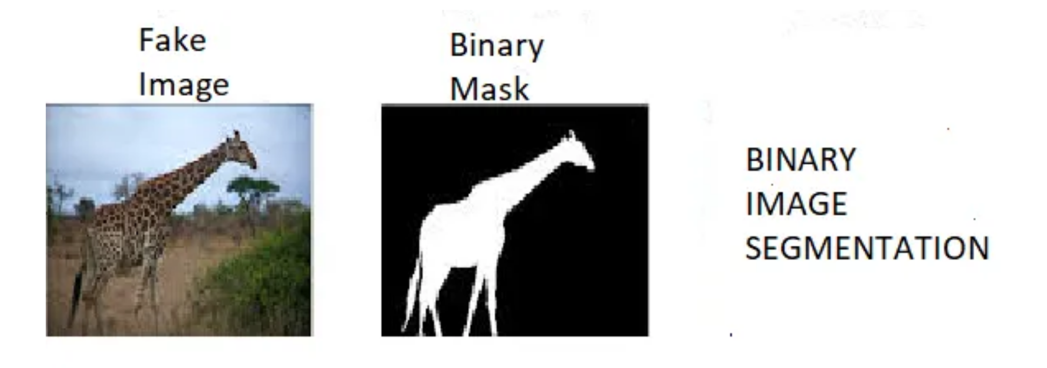
Our Workflow

Slide 10
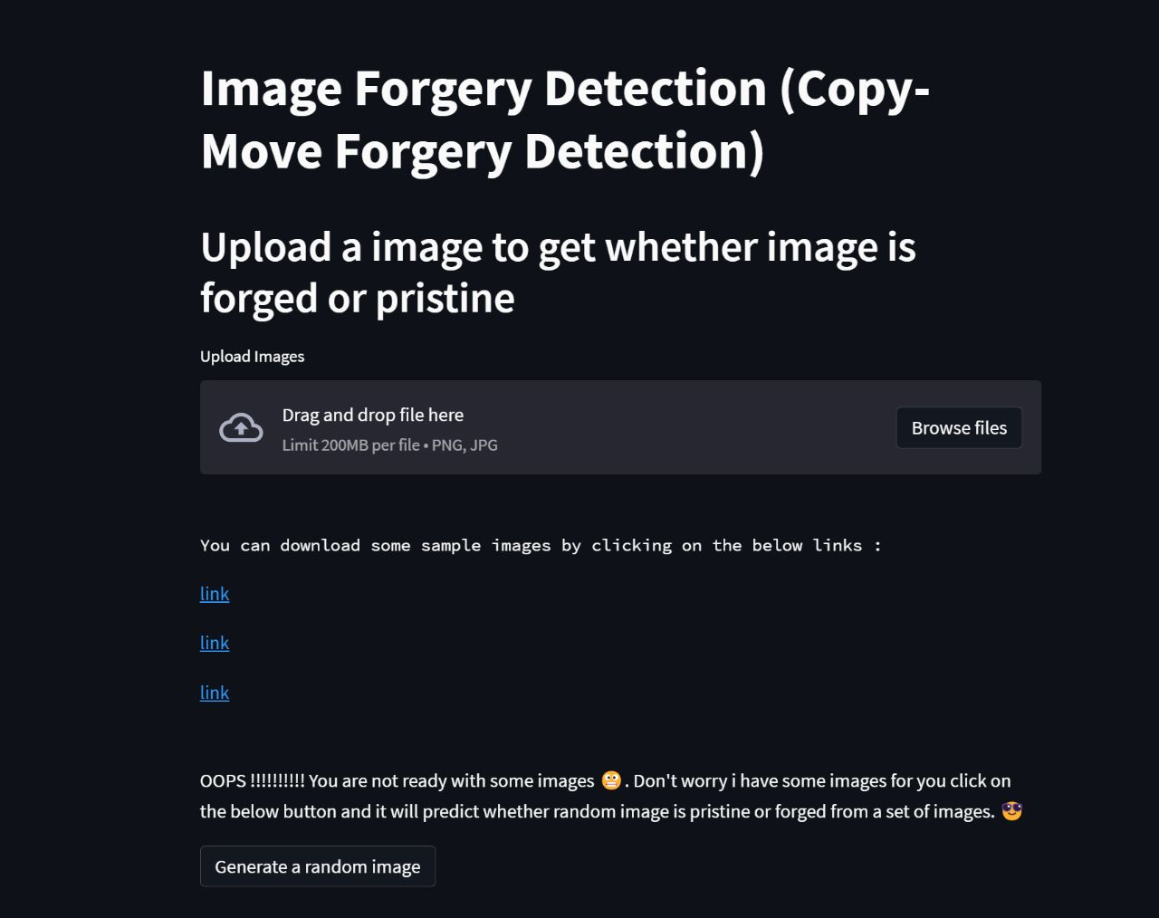
Interface

Slide 11
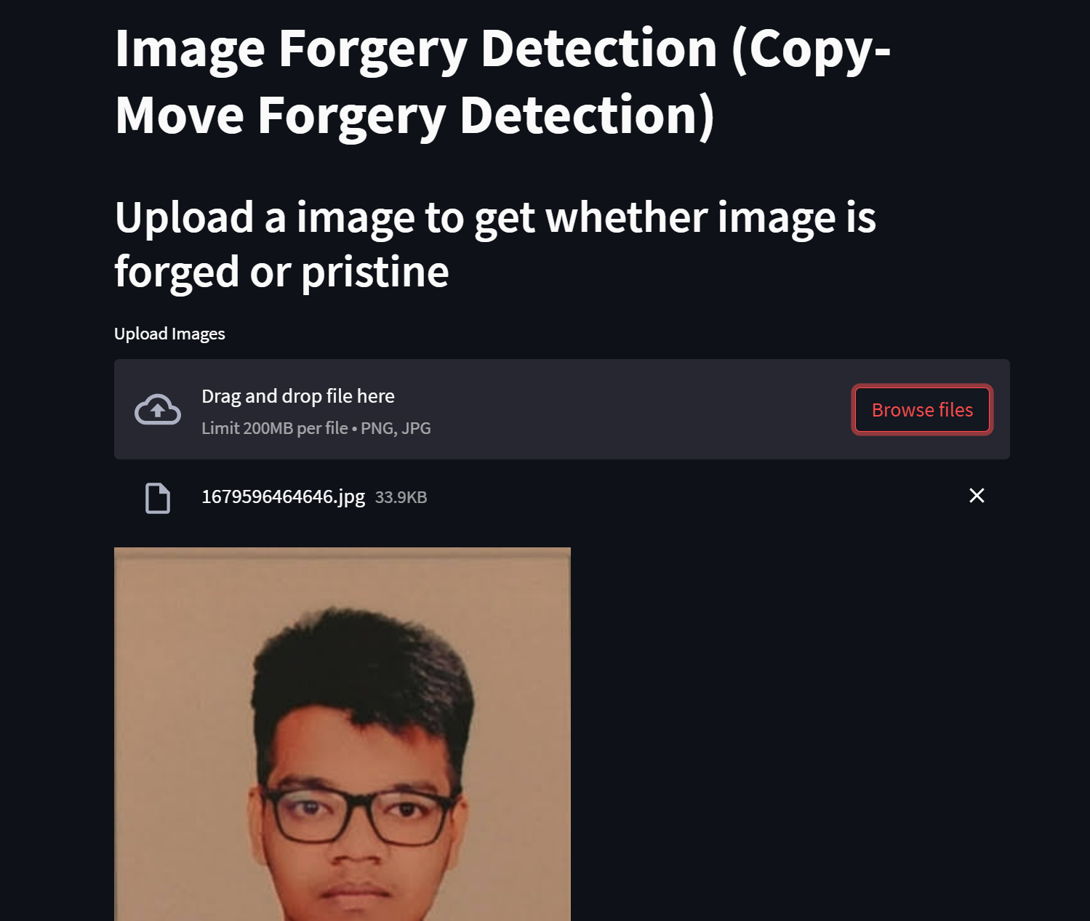
Interface

Slide 12
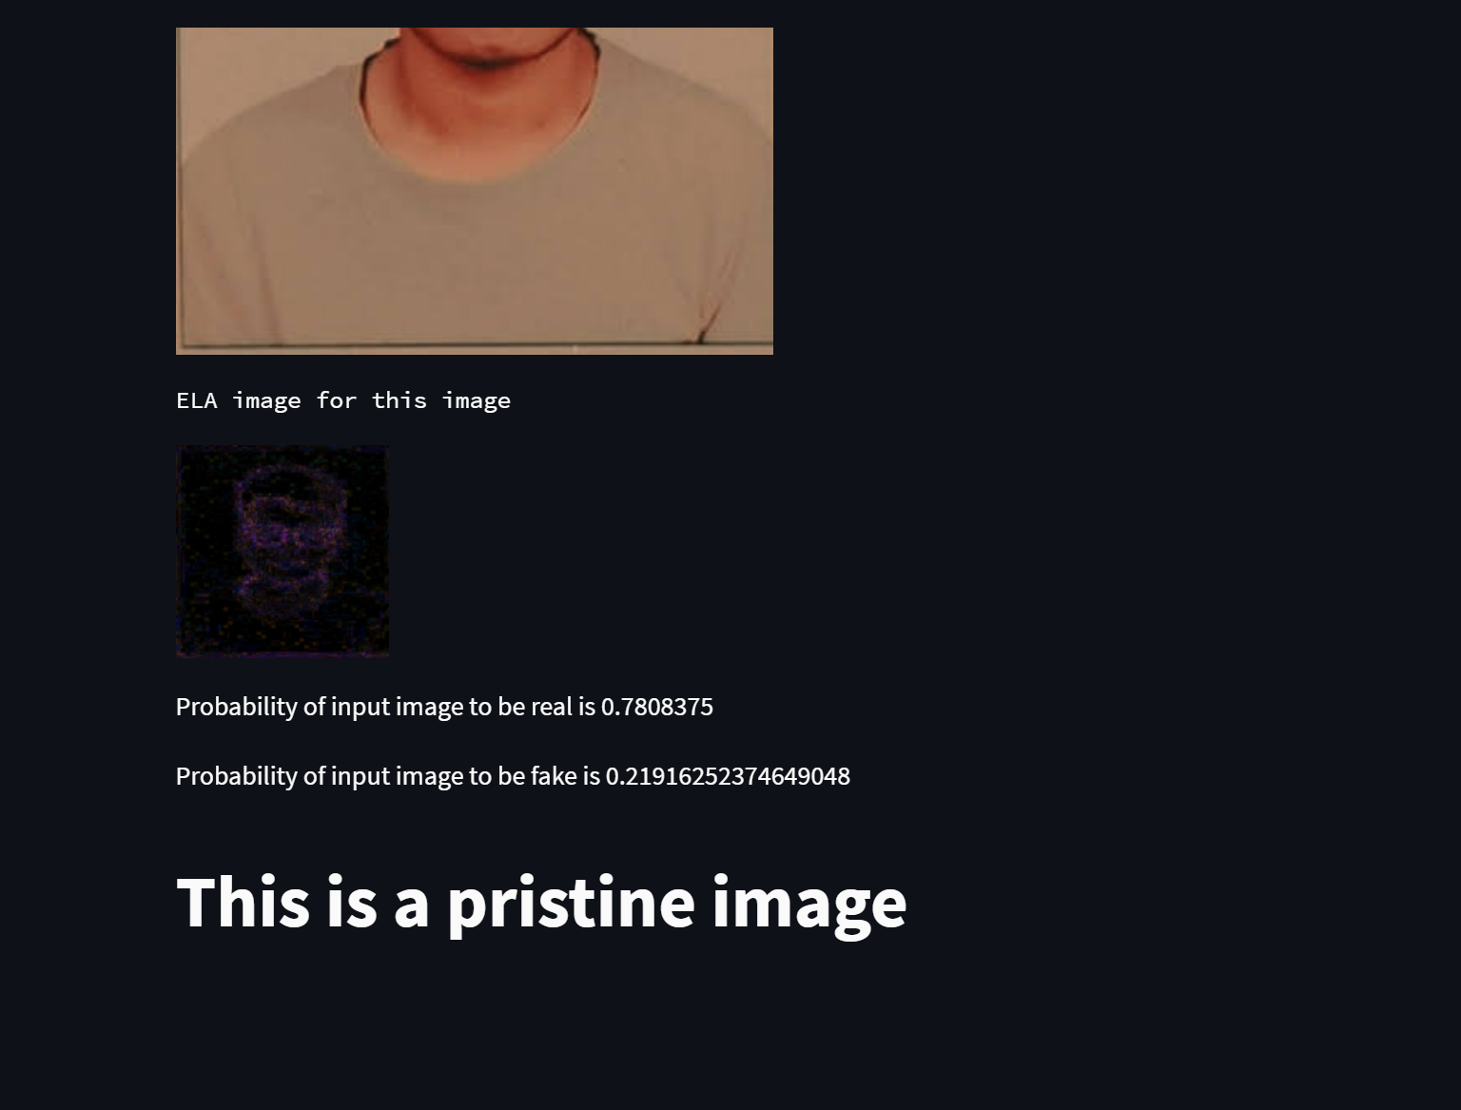
Interface

Slide 13
Conclusion
In the proposed system, we are trying to implement four different concepts of image forgery detection algorithms. The system is capable of taking input image and give out suitable outputs to solve the obstacle of forged images. The system can be used in law and enforcements and cyber security to help the user to differentiate between legitimate and tampered images

